Slide 1

ROAD ACCIDENTS ANALYSIS
KARMUKILAN D K
2021 - 2022

Slide 2
Contents
Data Overview
Data Cleaning and Preparation
Key Findings
Conclusion
Recommendations

Slide 3
Dataset Overview
Dataset Description:
The dataset contains records of road accidents, providing detailed information about each incident.
Time Period:
The data covers accidents from January 1, 2021, to December 31, 2022.
Total Records:
The dataset comprises 307,973 accident records.

Slide 4
Data Cleaning and Preparation
Handling Missing Values:
Identified missing values using isnull().sum() and visualized them with a heatmap.
Addressed missing values in "Carriageway_Hazards" and "Time" columns.
Data Type Conversion:
Converted "Accident Date" to datetime format using pd.to_datetime.
Extracted time features (year, month, day, hour) from "Accident Date" and "Time".

Slide 5

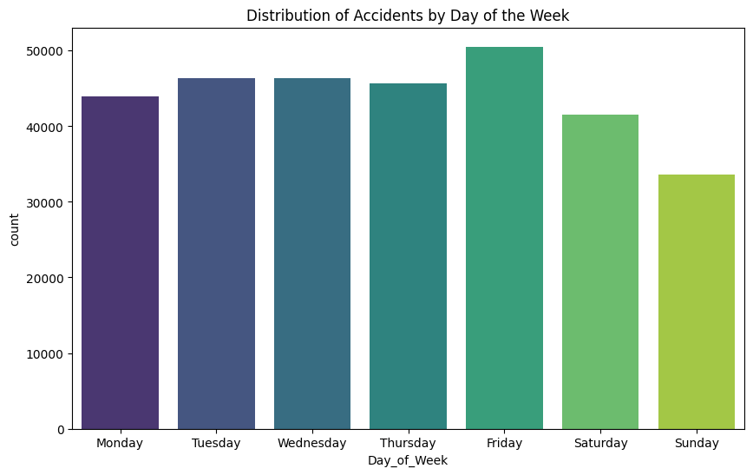
Key Findings
Accident Distribution:

Slide 6
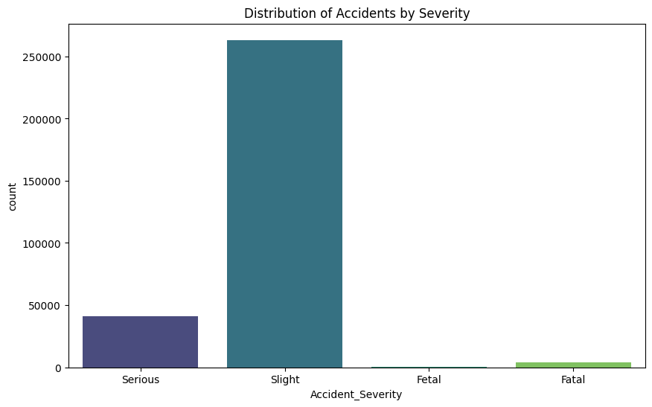
Accident Severity:

Slide 7

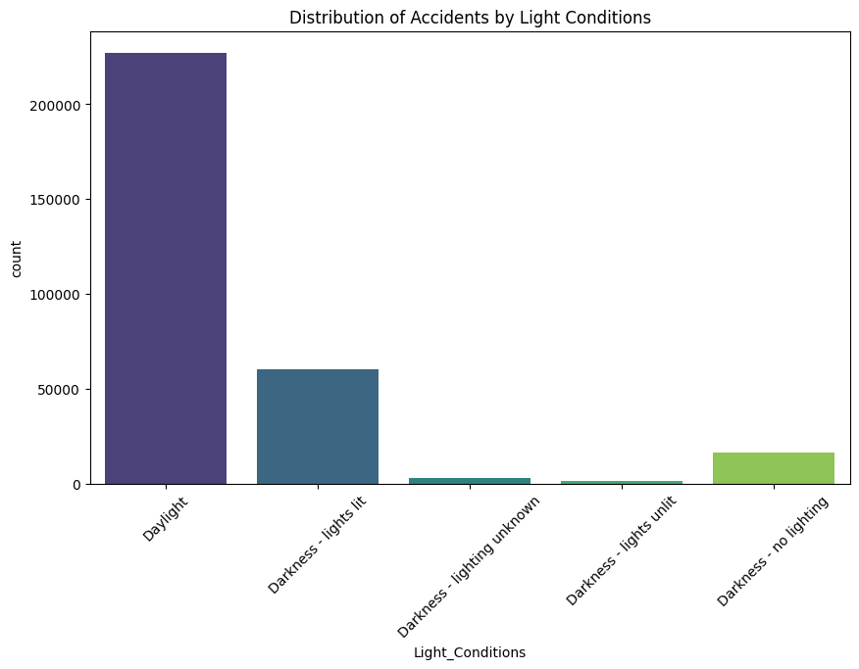
Light Conditions

Slide 8

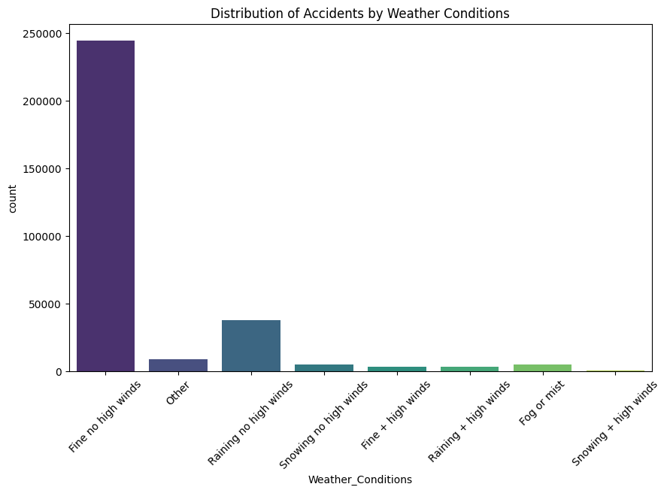
Weather Conditions

Slide 9
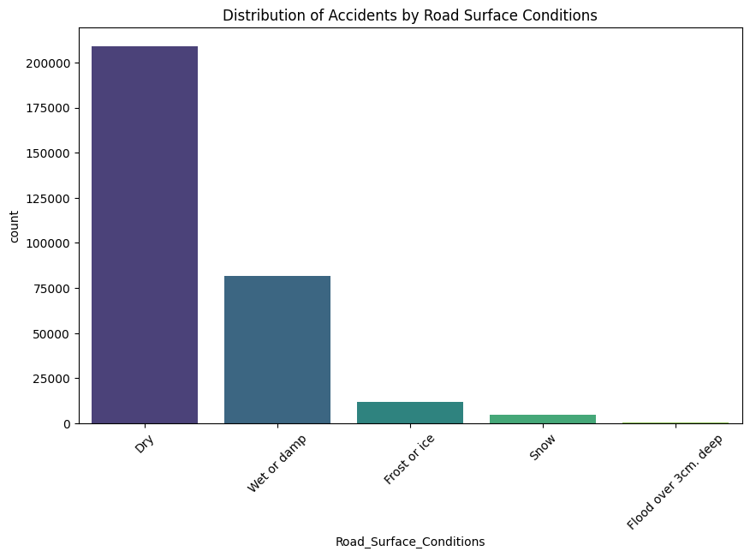

Road Surface Conditions

Slide 10
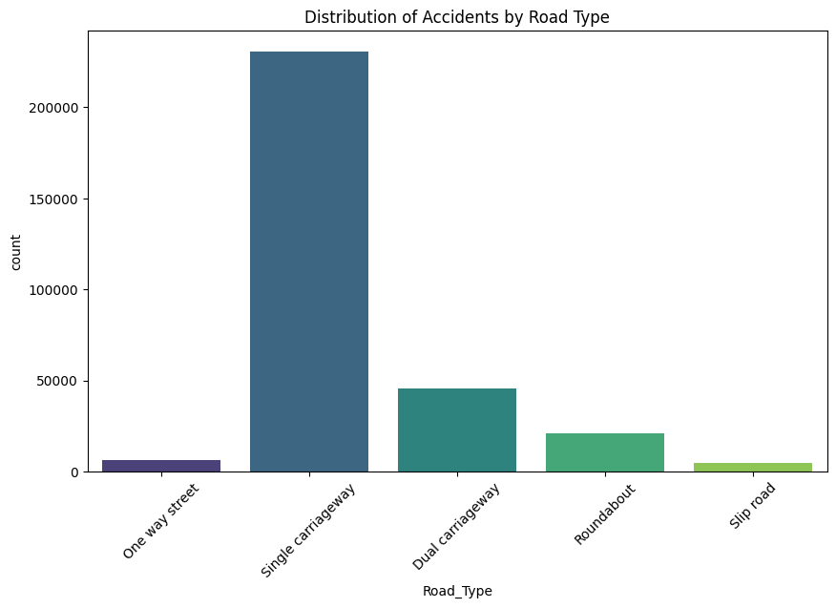

Road Type

Slide 11
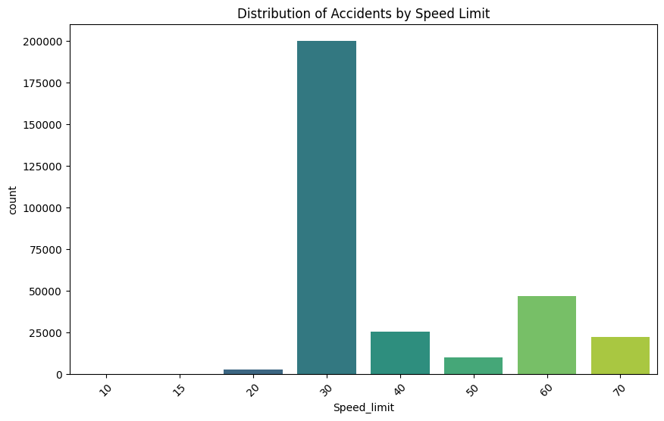

Speed Limit

Slide 12
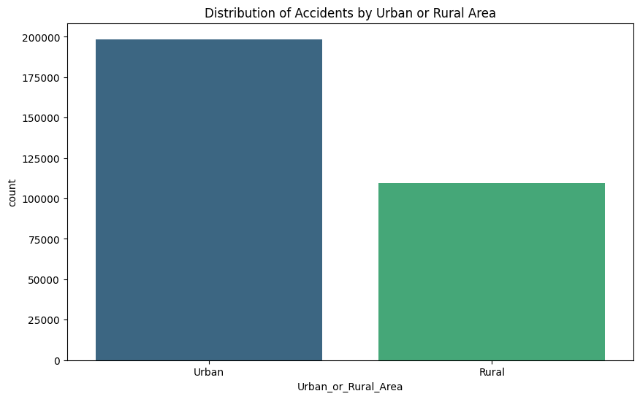

Area

Slide 13
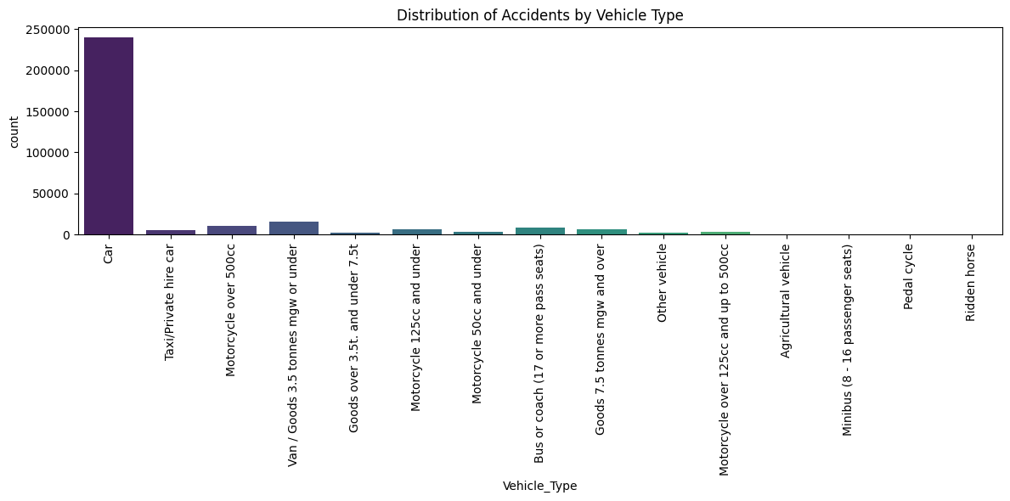

Vehicle Type

Slide 14
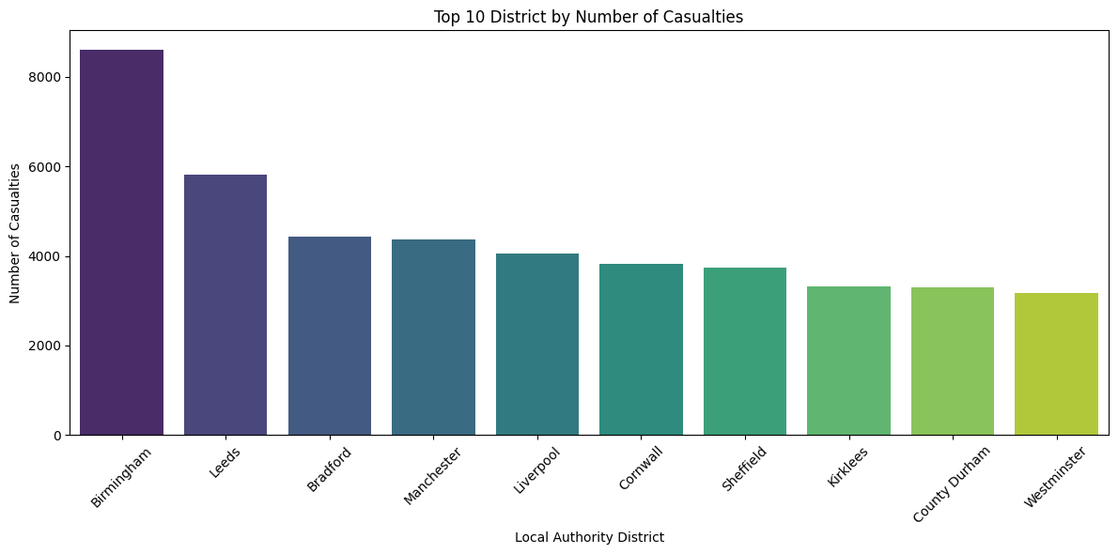

Most Common Districts

Slide 15
Conclusion
Accidents are frequent, with Friday being the most common day.
Many accidents occur at junctions with "Give way or uncontrolled" control.
Most accidents are classified as "Slight" emphasizing the need for preventive measures.
Dry road surfaces are prevalent during accidents.
Single carriageway roads witness the highest accident rates.
Local Authority (District) Birmingham has is associated with the highest number of reported accidents
Accidents often occur in areas with a speed limit of 30 mph.
Fine weather conditions without high winds are common during accidents.
Urban areas experience more accidents compared to rural areas.
Cars are frequently involved in accidents.

Slide 16
Recommendation
Implement advanced safety measures at junctions with "Give way or uncontrolled" controls.
Focus on preventive measures through awareness campaigns and driver education programs.
Ensure regular maintenance of roads, especially on single carriageway roads.
Implement targeted safety initiatives in high accident areas like Birmingham.
Enforce speed limits through speed cameras and traffic calming measures.
Educate drivers on safe driving practices in all weather conditions.
Implement urban safety strategies such as pedestrian-friendly infrastructure.
Promote vehicle safety features and enforce regulations related to vehicle maintenance.

Slide 17


Slide 18

Thank You!
Safe Driving !!!
Please keep this slide for attribution

